Slide 1





Slide 2






Slide 3
Our Team

Slide 4

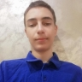
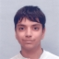
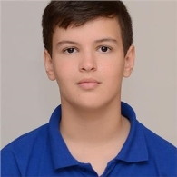
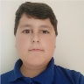
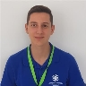


Our project wouldn’t be possible without:
Our Backend Developers:
Our Scrum Trainer:
Our Quality Engineer:
Our Mentor:
&
Galin Georgiev
Alexander Manov
Valeri Ivanov
Kaloyan Lambov
Nikola Peshev

Slide 5
Our Idea

Slide 6


But why eight ball pool?
We chose to make eight ball pool because we wanted to show what we have learned throughout the year and to show our skills and what we can do as a team.
We also really like the game.

Slide 7
Our Progress

Slide 8









Here’s our thought process:
Team initiation
Brainstorming
Presenting
Working on tasks
Documentation
Repo Creation
13.11.2021
07.12.2021

Slide 9
Used Tech

Slide 10







The tech we used to make our project:

Slide 11
Our Demo

Slide 12
*Demo goes here*

